Slide 1
Introduce about Research Field: Beam modeling analysis
Doan Manh Hung

Slide 2
Contents
Introduction
Main purpose
Conclude

Slide 3
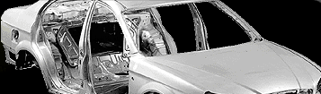
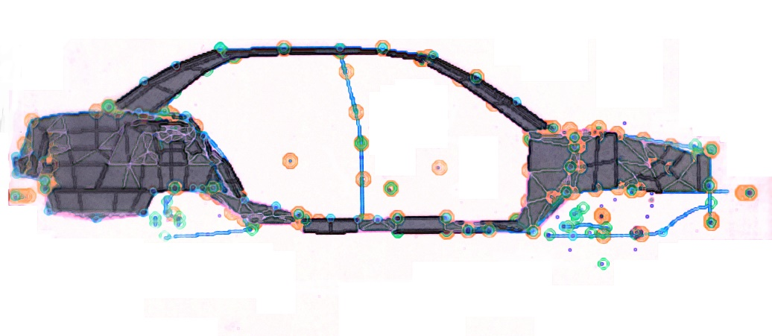
Introduction
Automobile Body Design
Shell/Plate
Beam
Joint Spring or Joint Rate
Initial-Design Stage Finite Element Modeling of Automobile Body: Beam/Joint

Slide 4
Initial Design Purpose
Joint Spring
Beam
Motivation for Beam Modeling ?
Accurate Response
Beam
Beam models
1) give more design freedom in initial body configuration,
2) are computationally much more efficient than Shell Models,
3) However, it is very difficult to have Good Beam Models.
Plate/shell

Slide 5
In Auto Bodies, Thin-walled Closed Beams are Used as the Main Load Carrying Members….
B-Pillar
In Comparison with open beams
They Have better Stiffness-to-Mass Ratios than Solid Beams
They Have Higher Torsional Rigidity than Open Beams
But, their structural behavior is not so simple……

Slide 6
* Usual Deformations: Extension, Bending and Torsion
Investigate deformation patterns:
Extension
(1 D.O.F)
Flexure/Bending
(2 D.O.F X 2 = 4 D.O.F)
Torsion
(1 D.O.F)
6 D.O.F

Slide 7
Analysis for Straight Box Beams
y
=
+
x
Straight Box Beam
z
Extension (1 DOF)
Flexure/Bending (4 DOF)
+
+
+
Torsion(1 DOF)
Distortion (1 DOF)
Warping(1 DOF)
These three DOF’s are coupled→ Need New Analysis

Slide 8
Our Higher-Order Beam Theory Will Consider Additional Section Deformations!!
Thin-Walled “Straight” Box Beams and Results
“Curved” Box Beams and Results,
Thin-walled Closed Beams having General Sections (straight case)

Slide 9
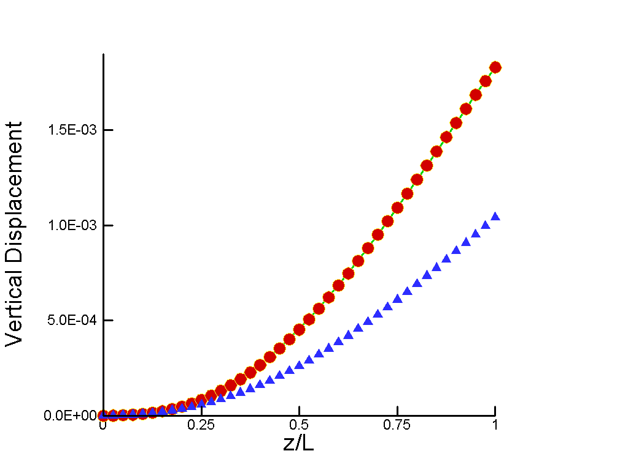
Verification in a Curved Box Beam, Static (Out of Plane)
R=500mm
b=25mm
h=50mm
t=1mm
=90deg
V=1N
Plate element
Fixed
Rigidly constrained
Present Beam
(5DOF)
Timoshenko beam
(3DOF)
Present Theory : Torsion + Flexure + Bending +
Warping + Distortion

Slide 10
Thank you for concentration!

